Slide 1
COS70006
OOP
Using BlueJ, an introduction
Notes:
SDJ Lecture 3 : Java & BlueJ
© Swinburne or © Pearson Education, IncA Bayley
A Bayley

Slide 2
Overview
Objective
  Students should be able to use some of the BlueJ tools to make and inspect their own objects
These slides summarize the use of BlueJ in Chapter 1 pp1-17 of
  Barnes & Kolling Objects First with Java: A Practical Introduction using BlueJ, 5th ed, Pearson (2012)

Slide 3
What is BlueJ?
Software supplied with Barnes & Kolling’s text but freely available
Software tied to the text that can be downloaded from
  http://www.bluej.org/download/download.html
You can read about it here
  http://www.bluej.org/about/what.html
It is a teaching aid
It is not a full-featured IDE but good enough as a learning tool
Java is more than BlueJ but a great way to start!

Slide 4


After you install it
You can run BlueJ from here
You can select which JVM you would like BlueJ to use
You may have a desk top Icon

Slide 5
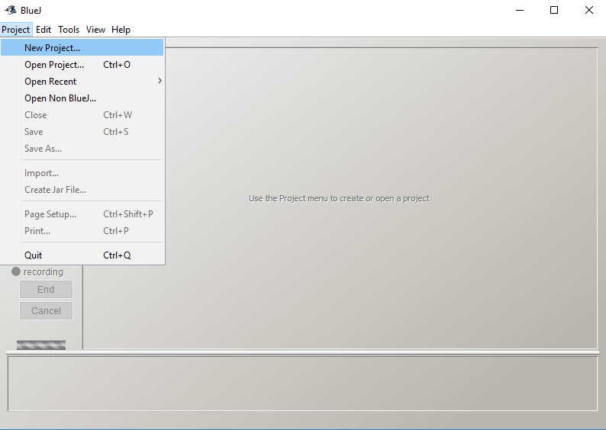
BlueJ Projects
We work with projects
You can create new projects
A project is essentially a folder containing a file named package.bluej plus source files.
(ctxt files are created for “housekeeping”.)

Slide 6
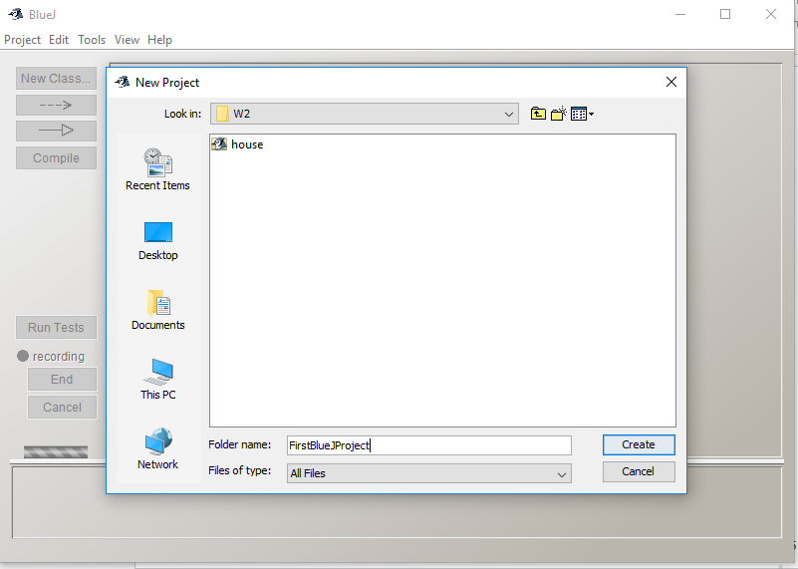

To create a new project…
Give the project name
(will create folder with the project name)

Slide 7
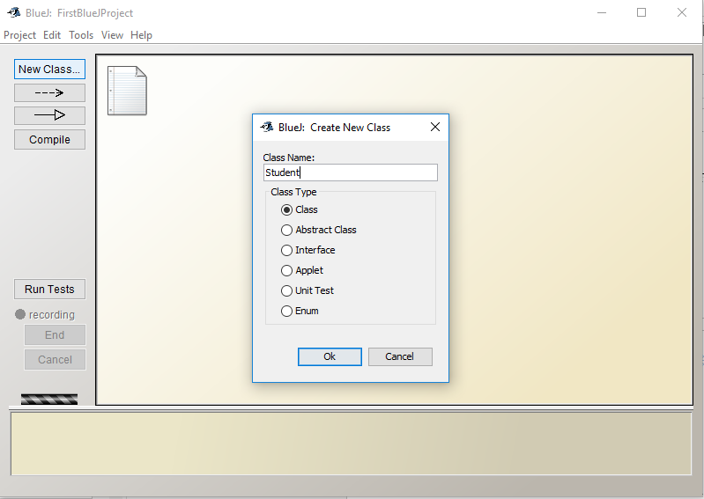
To create a new Class…
1. Click on new Class…
2. Enter the class name

Slide 8
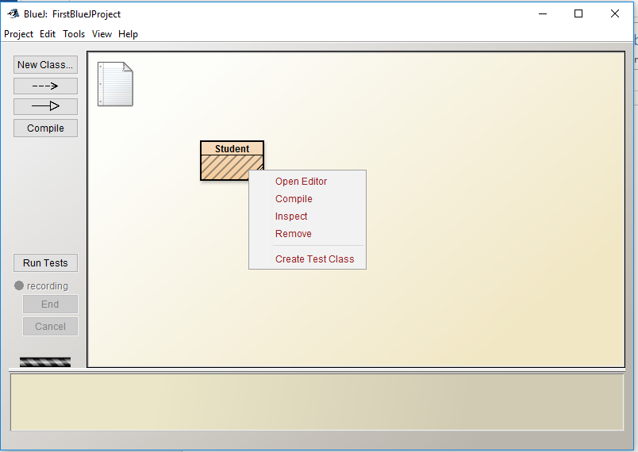
After creating a class, you can…
Edit the code
Compile the code
Have a look at the class features
Delete this class

Slide 9
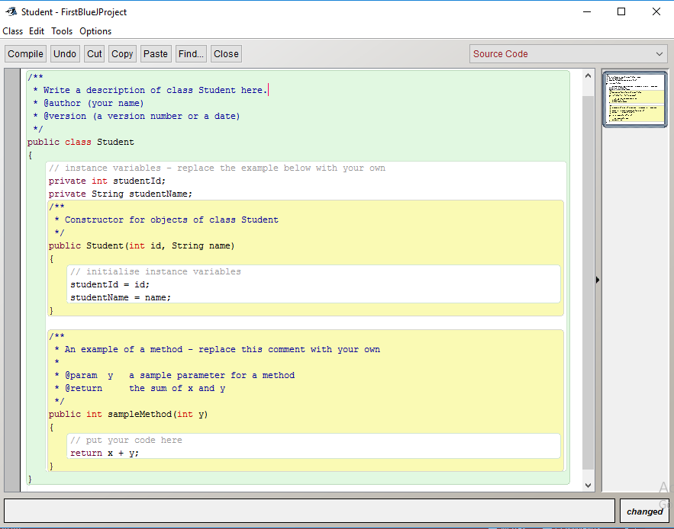
After opening the editor you can write Java code

Slide 10
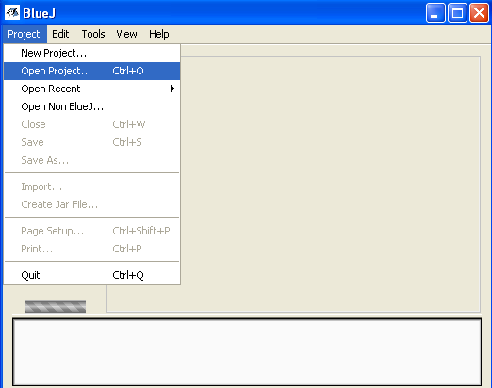
To open a project
Open projects written by others
(We will be using some projects
supplied with the text book)

Slide 11
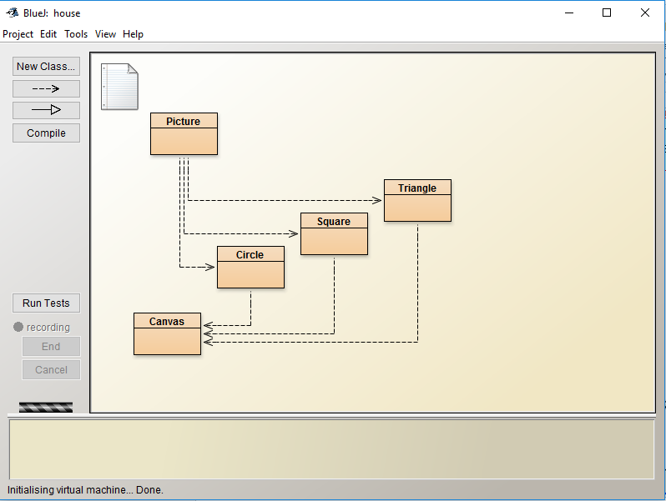
After opening a project: E.g. House
See the classes that make up the project. These can all be used to define objects.
See the relationships between classes. Picture uses Triangle, etc.

Slide 12
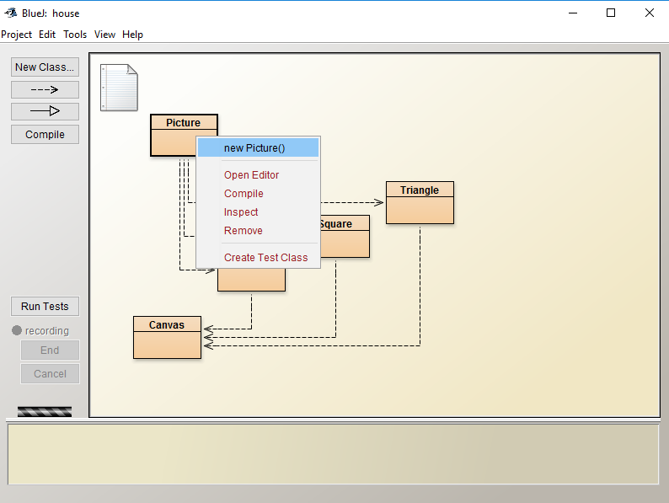
Right-clicking on a class allows you to
Create an Object based on this class

Slide 13
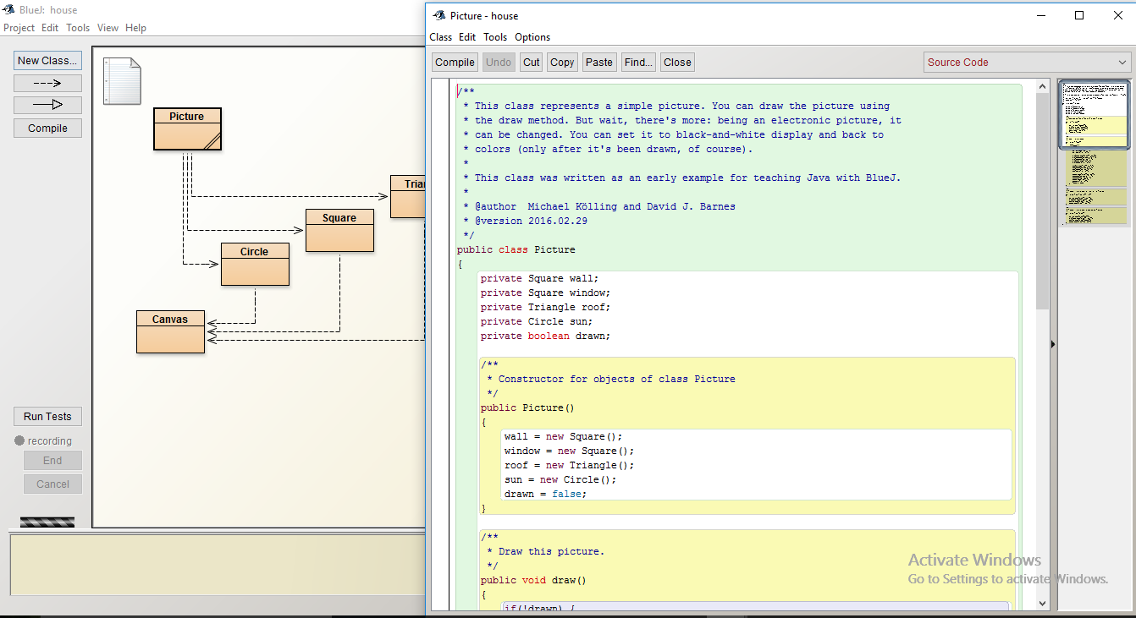
After opening the editor see Java code

Slide 14
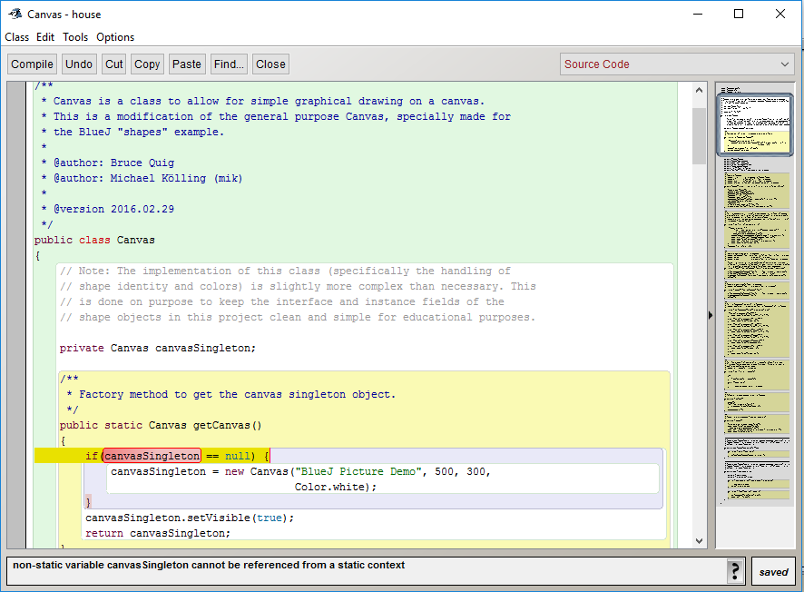
A program will not compile if there is an error in the code
Error!

Slide 15
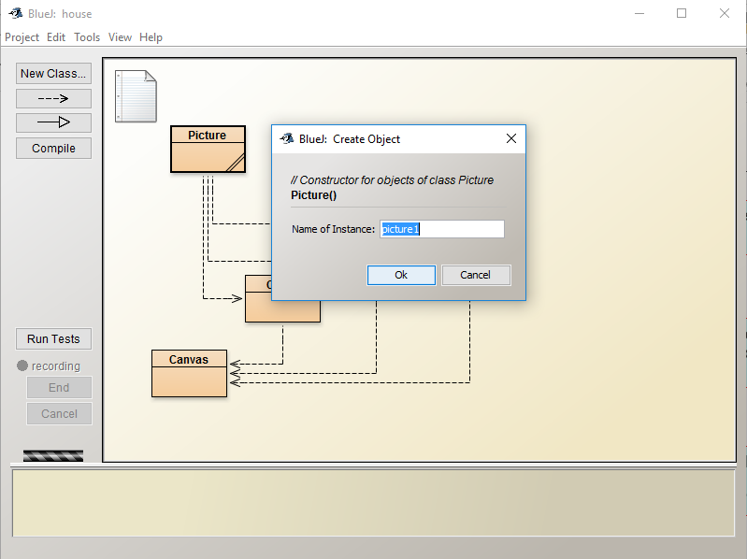
You can create objects
Right click
Dialog for necessary information
You must name your object
(A reference in the code to the object created)
Once created, objects appear here:
“Object Tray”

Slide 16
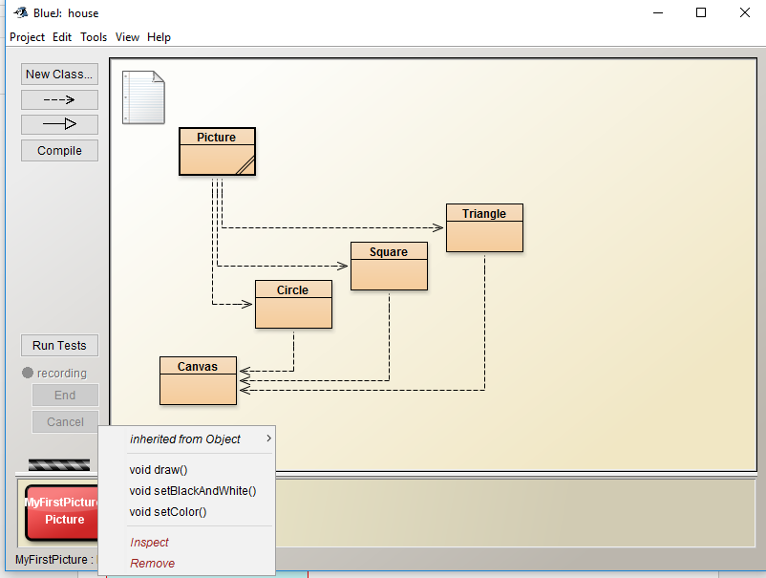
Playing with the objects created…
Objects by default inherit from other classes, ignore this for now
This is what this object can DO,
the methods
Right click on object to see what it will do
You can learn about what this object KNOWS (attributes)

Slide 17
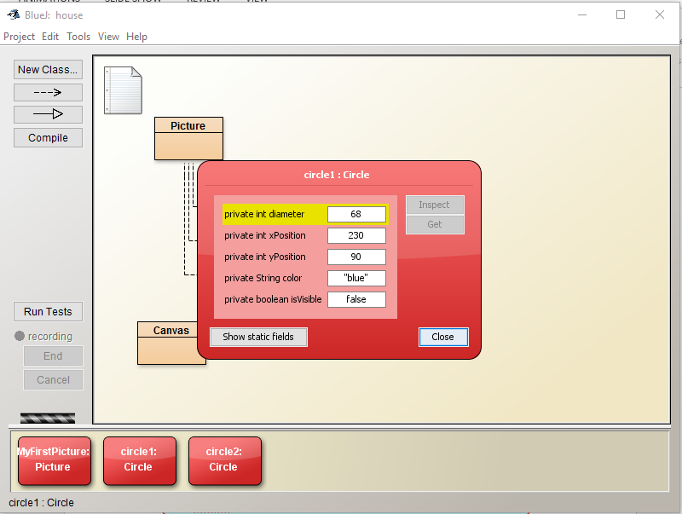
The state of the object, its instance variables
Instances of the same class will have the same attributes but different STATE.
A Project will normally have many objects
Object creation is normally part of your program code but BlueJ can do it for you

Slide 18
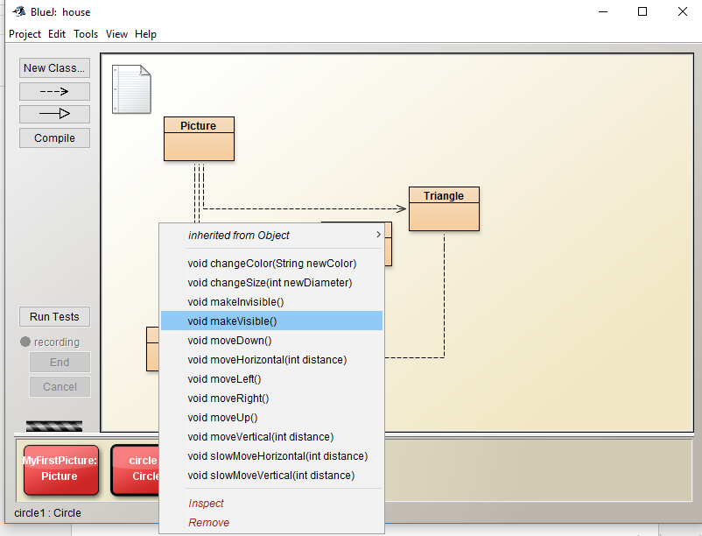
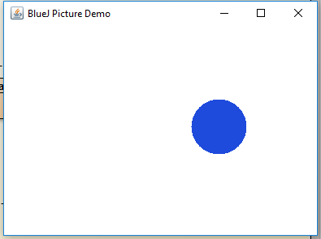
Invoking methods
You can invoke the object's behaviour by selecting the methods
Notes:
This is all easy because you are working with BlueJ. Behind the scenes, a program has created the circle object and a canvas object and opened a window to show them. Task Manager shows a new application running
SDJ Lecture 3 : Java & BlueJ
© Swinburne or © Pearson Education, IncA Bayley

Slide 19
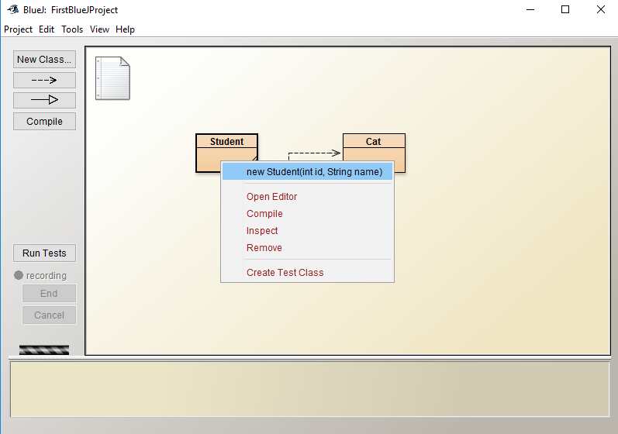
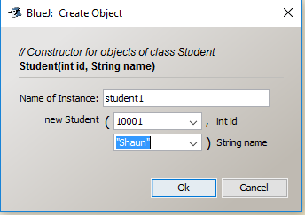
Providing parameters when creating objects:
Back to Student and Cat project
Right click Student class and click on new Student…
Required types shown

Slide 20
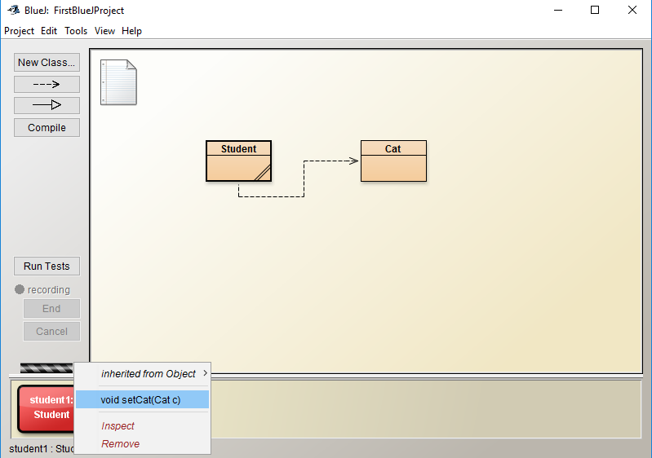
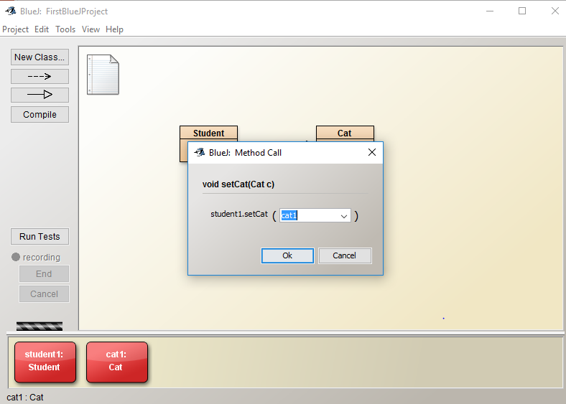
Providing reference parameters
faster than typing cat here
2. Click on desired object in the tray
1. Right-click
setCat(...

Slide 21

Reading
BlueJ Chapter 1, pages 1-17
Some useful videos (BlueJ)
  https://www.youtube.com/watch?v=LIbL64bBO9s
  https://www.youtube.com/watch?v=9goaOqbkC24
  https://www.youtube.com/watch?v=Y9gOv-swR9M

